Slide 1

The History of Artificial Intelligence
Artificial Intelligence has come a long way since it’s initial inception by Alan Turing in 1950.
We will be going through various milestones in the history of Artificial Intelligence.

Slide 2

1950
Alan Turing published “Computing Machinery and Intelligence,” which proposed the idea of The Imitation Game – a question that considered if machines can think. This proposal later became The Turing Test, which measured machine (artificial) intelligence. Turing’s development tested a machine’s ability to think as a human would. The Turing Test became an important component in the philosophy of artificial intelligence, which discusses intelligence, consciousness, and ability in machines.

Slide 3
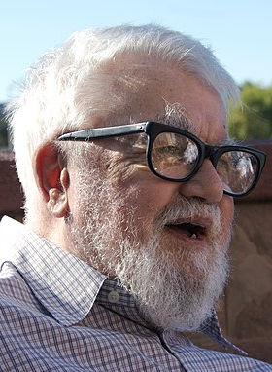
1955
John McCarthy and a team of men created a proposal for a workshop on “artificial intelligence.” In 1956, when the workshop took place, the official birth of the word was attributed to McCarthy.

Slide 4
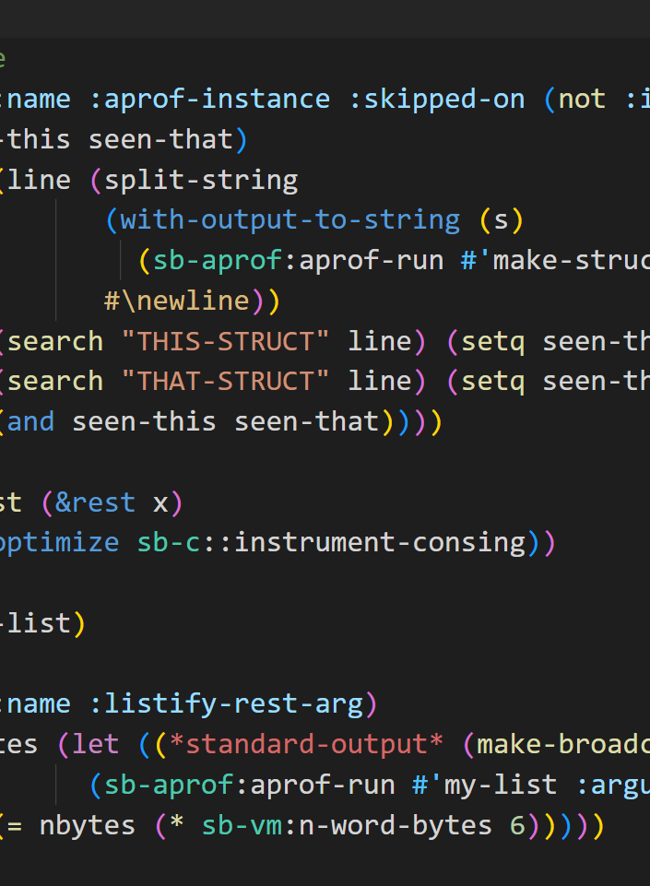
1958
McCarthy developed Lisp, the most popular and still favored programming language for artificial intelligence research.

Slide 5
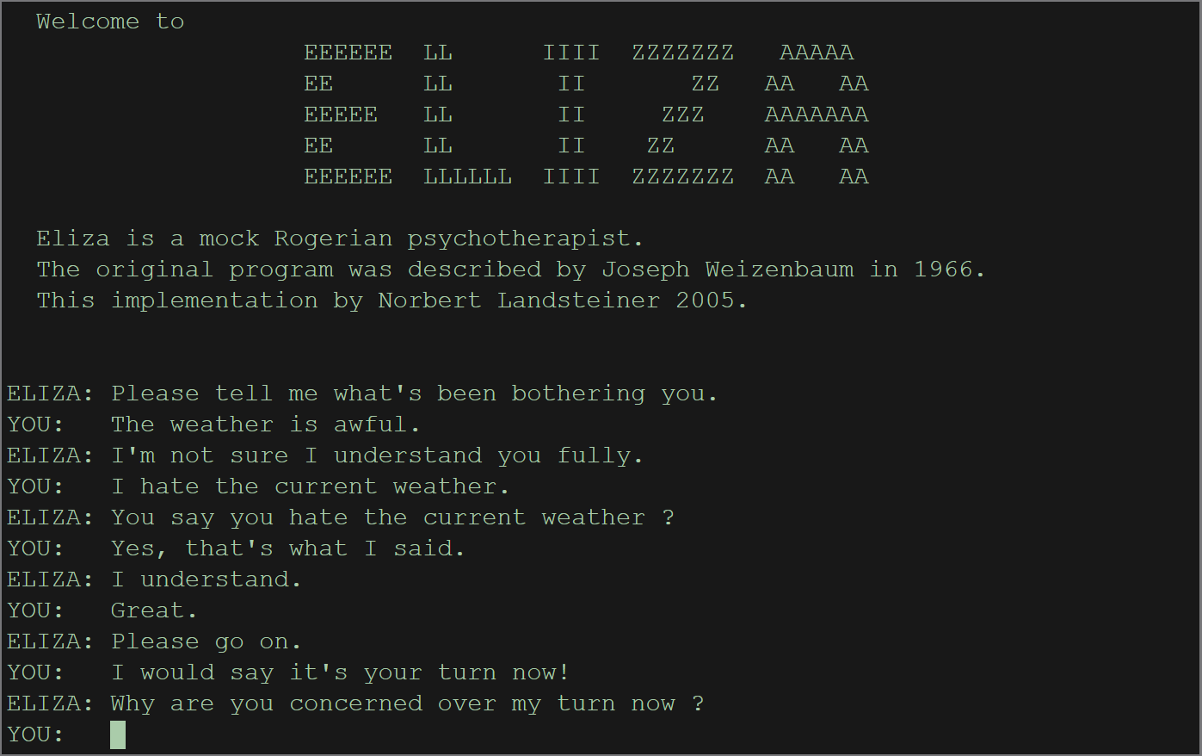
1965-66
Joseph Weizenbaum, computer scientist and professor, developed ELIZA, an interactive computer program (chatbot) that could functionally converse in English with a person. Weizenbaum’s goal was to demonstrate how communication between an artificially intelligent mind versus a human mind was “superficial,” but discovered many people attributed anthropomorphic characteristics to ELIZA.

Slide 6
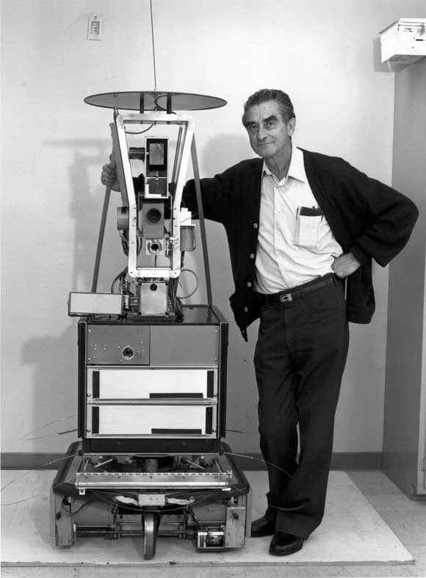
1966
Shakey the Robot, developed by Charles Rosen with the help of 11 others, was the first general-purpose mobile robot, also known as the “first electronic person.”

Slide 7
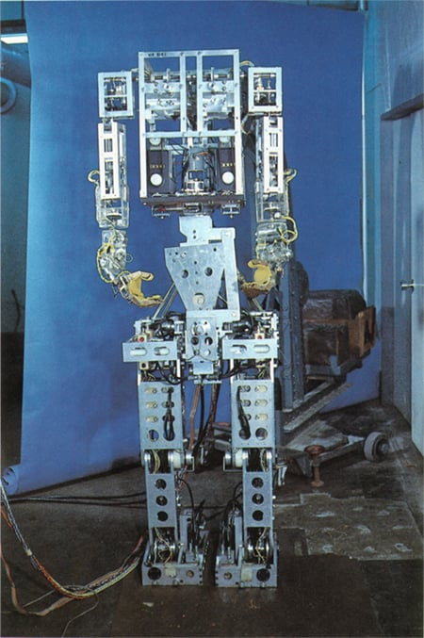
1970
WABOT-1, the first anthropomorphic robot, was built in Japan at Waseda University. Its features included movable limbs, ability to see, and ability to converse.

Slide 8
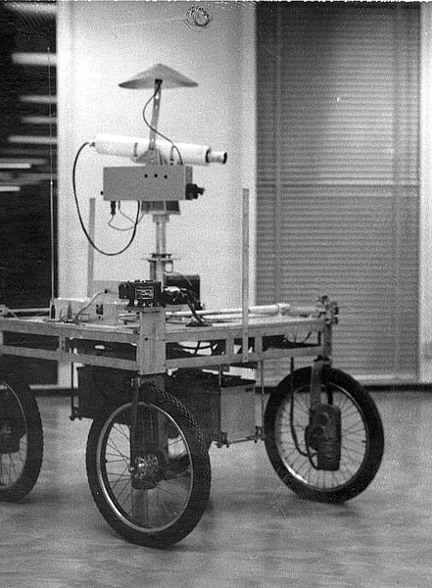
1979
The Stanford Cart, a remote controlled, tv-equipped mobile robot was created by then- mechanical engineering grad student James L. Adams in 1961. In 1979, a “slider,” or mechanical swivel that moved the TV camera from side-to-side, was added by Hans Moravec, then-PhD student. The cart successfully crossed a chair-filled room without human interference in approximately five hours, making it one of the earliest examples of an autonomous vehicle.

Slide 9
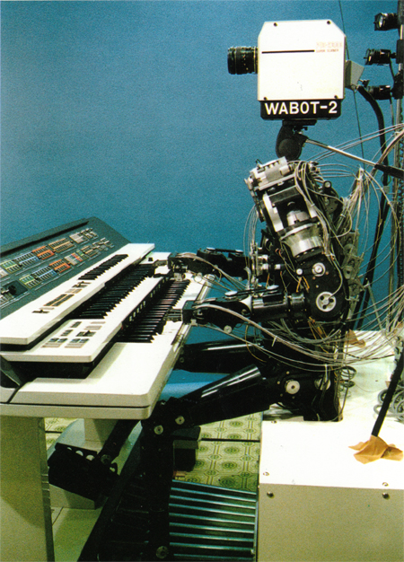
1980
WABOT-2 was built at Waseda University. This inception of the WABOT allowed the humanoid to communicate with people as well as read musical scores and play music on an electronic organ.

Slide 10
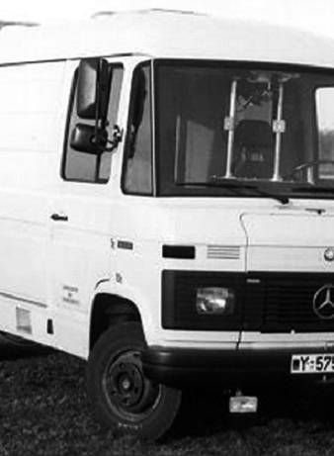
1986
Mercedes-Benz built and released a driverless van equipped with cameras and sensors under the direction of Ernst Dickmanns. It was able to drive up to 55 mph on a road with no other obstacles nor human drivers.

Slide 11
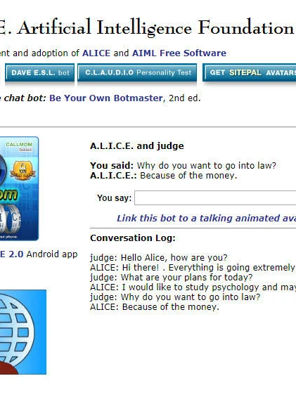
1995
Computer scientist Richard Wallace developed the chatbot A.L.I.C.E (Artificial Linguistic Internet Computer Entity), inspired by Weizenbaum's ELIZA. What differentiated A.L.I.C.E. from ELIZA was the addition of natural language sample data collection.

Slide 12
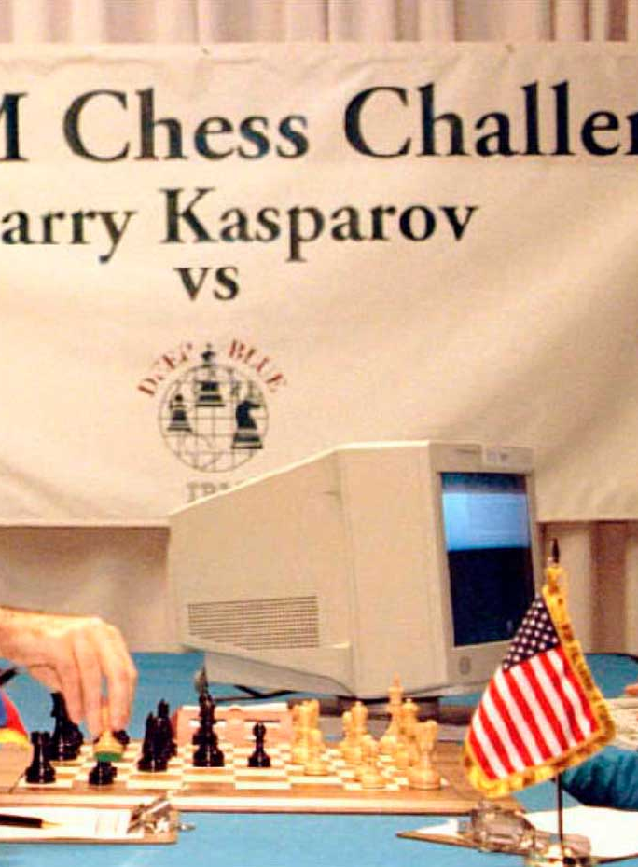
1997
Deep Blue, a chess-playing computer developed by IBM became the first system to win a chess game and match against the then reigning world chess champion, Garry Kasparov.

Slide 13
1999
Sony introduced AIBO (Artificial Intelligence RoBOt), a $2,000 robotic pet dog crafted to “learn” by interacting with its environment, owners, and other AIBOs. Its features included the ability to understand and respond to 100+ voice commands and communicate with its human owner.

Slide 14
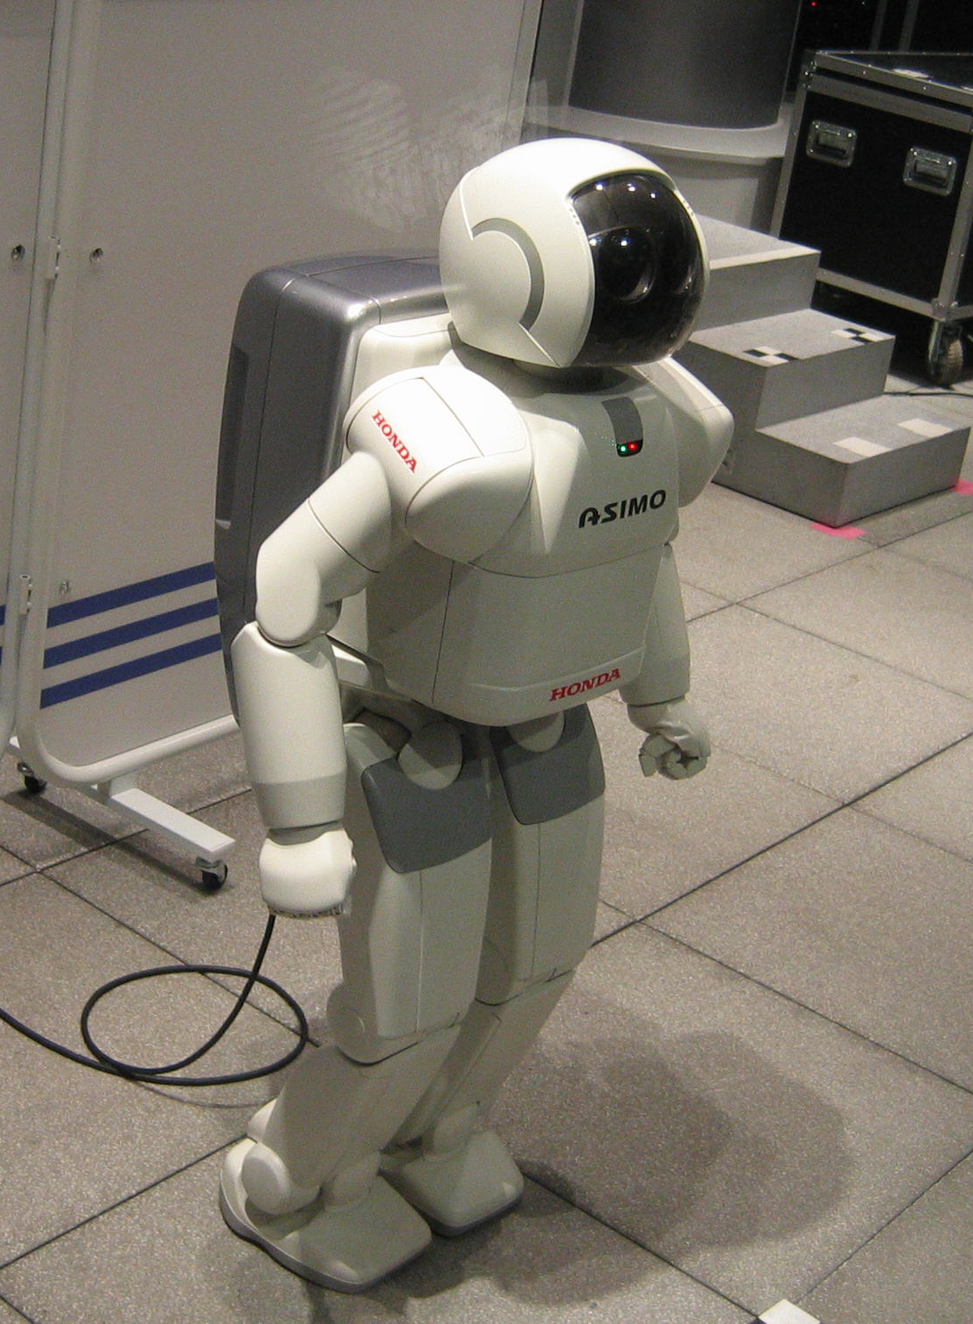
2000
Honda releases ASIMO, an artificially intelligent humanoid robot. It is currently displayed in the Miraikan museum in Tokyo, Japan.

Slide 15
2002
i-Robot released Roomba, an autonomous robot vacuum that cleans while avoiding obstacles.

Slide 16
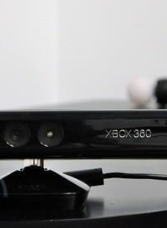
2010
Microsoft launched Kinect for Xbox 360, the first gaming device that tracked human body movement using a 3D camera and infrared detection.

Slide 17
2011
Watson, a natural language question answering computer created by IBM, defeated two former Jeopardy! champions, Ken Jennings and Brad Rutter, in a televised game.

Slide 18
2011
Apple released Siri, a virtual assistant on Apple iOS operating systems. Siri uses a natural-language user interface to infer, observe, answer, and recommend things to its human user. It adapts to voice commands and projects an “individualized experience” per user.

Slide 19
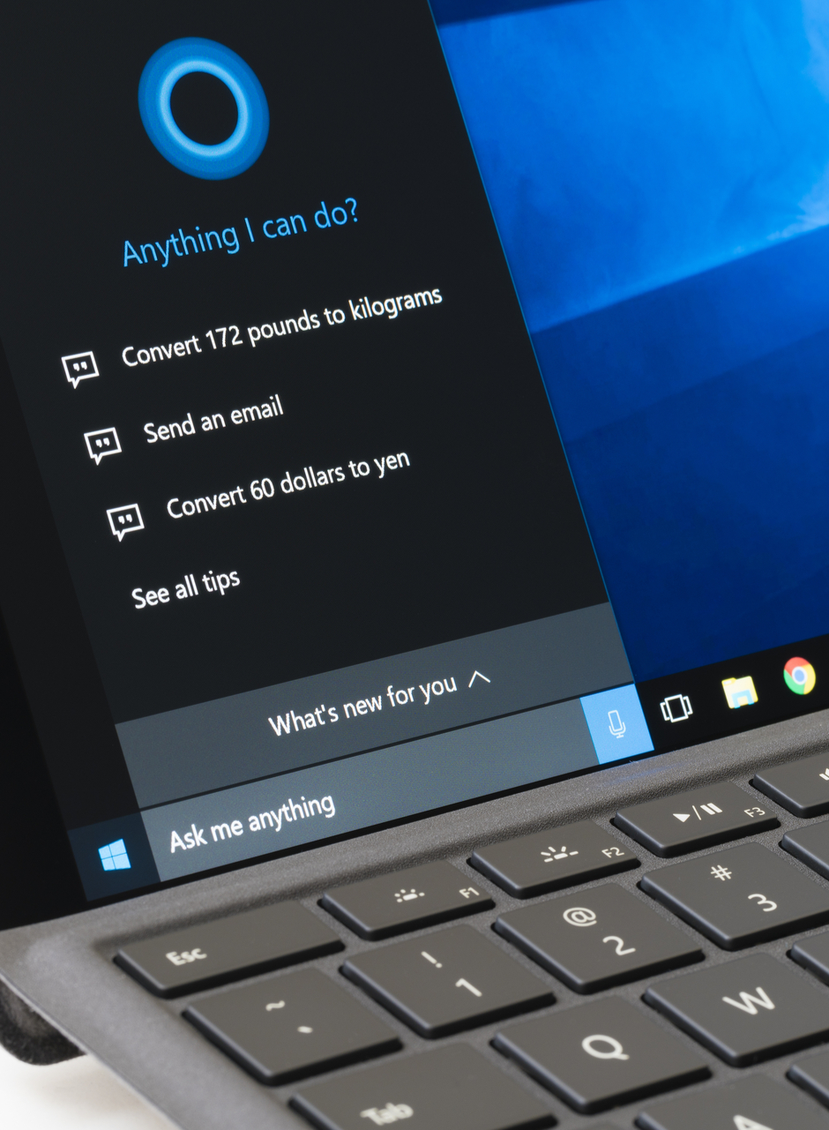
2014
Microsoft released Cortana, their version of a virtual assistant similar to Siri on iOS.

Slide 20
2014
Amazon created Amazon Alexa, a home assistant that developed into smart speakers that function as personal assistants.

Slide 21
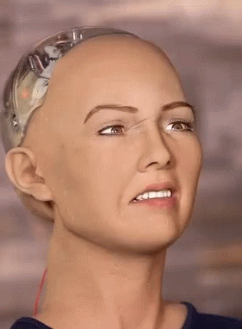
2016
A Humanoid Robot “Sophia” is created by Hanson Robotics. She is known as the first “robot citizen.” What distinguishes Sophia from previous humanoids is her likeness to an actual human being, with her ability to see image recognition make facial expressions, and communicate through AI.

Slide 22
2016
Google released Google Home, a smart speaker that uses AI to act as a “personal assistant” to help users remember tasks, create appointments, and search for information by voice.

Slide 23
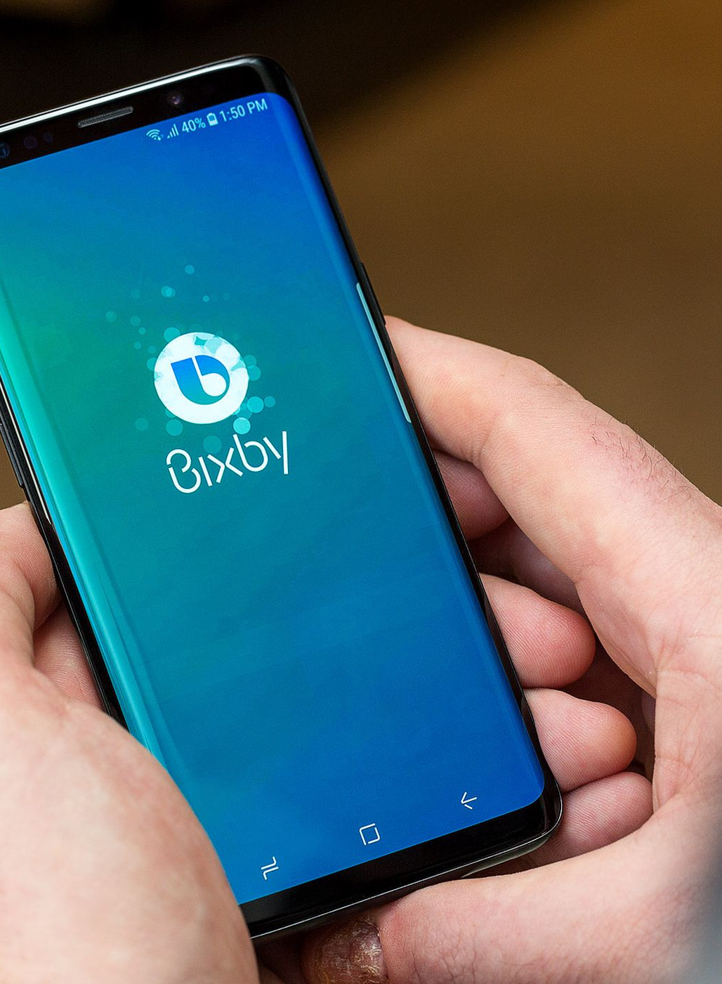
2018
Samsung introduced Bixby, a virtual assistant. Bixby’s functions include Voice, where the user can speak to and ask questions, recommendations, and suggestions; Vision, where Bixby’s “seeing” ability is built into the camera app and can see what the user sees (i.e. object identification, search, purchase, translation, landmark recognition); and Home, where Bixby uses app-based information to help utilize and interact with the user (e.g. weather and fitness applications.)

Slide 24
The end.
Presentation by Bharath S of class VIII C.

